Slide 1

Analyzing Biases in Perception of Truth in News Stories and their Implications for Fact Checking Mahmoudreza Babaei, Abhijnan Chakraboty, Juhi Kulshrestha, Elissa M. Redmiles, Meeyoung Cha, and Krishna P. Gummadi
FAT* 2019
Presented by Team 10 Inyong Koo, Minsu Kim
Notes:
The authors from Carnegie Mellon University (카네기 멜론대학교)

Slide 2
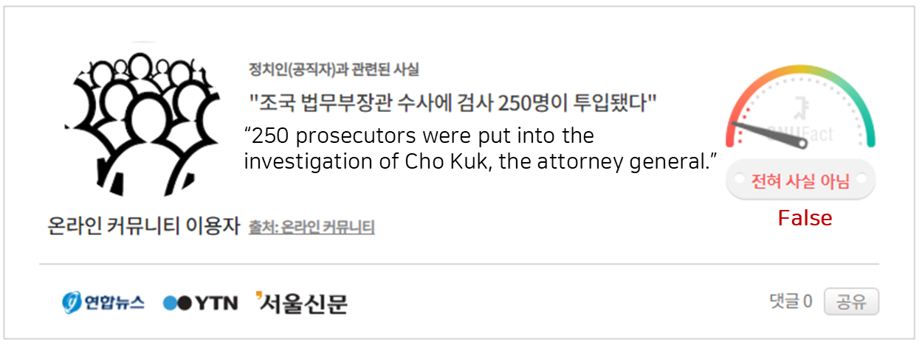
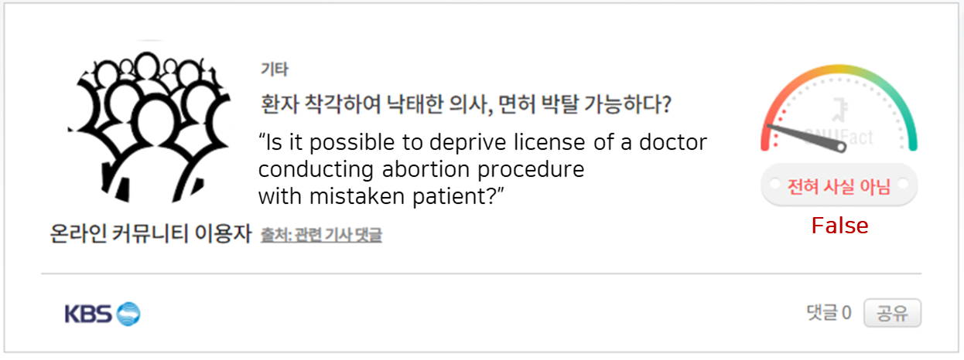
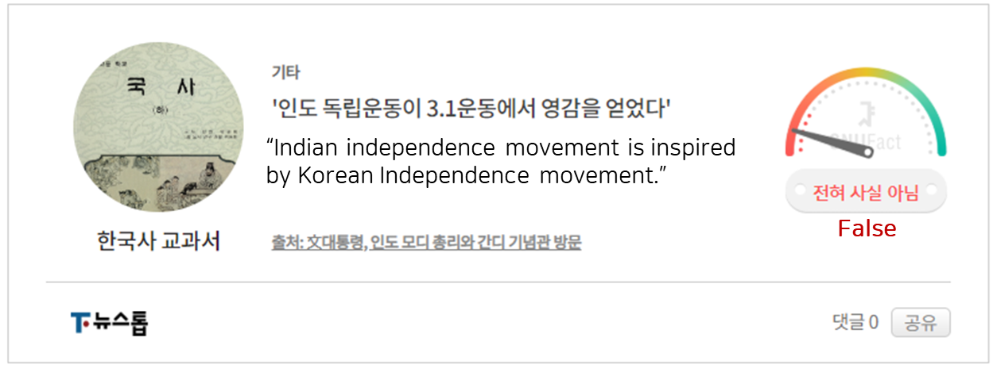
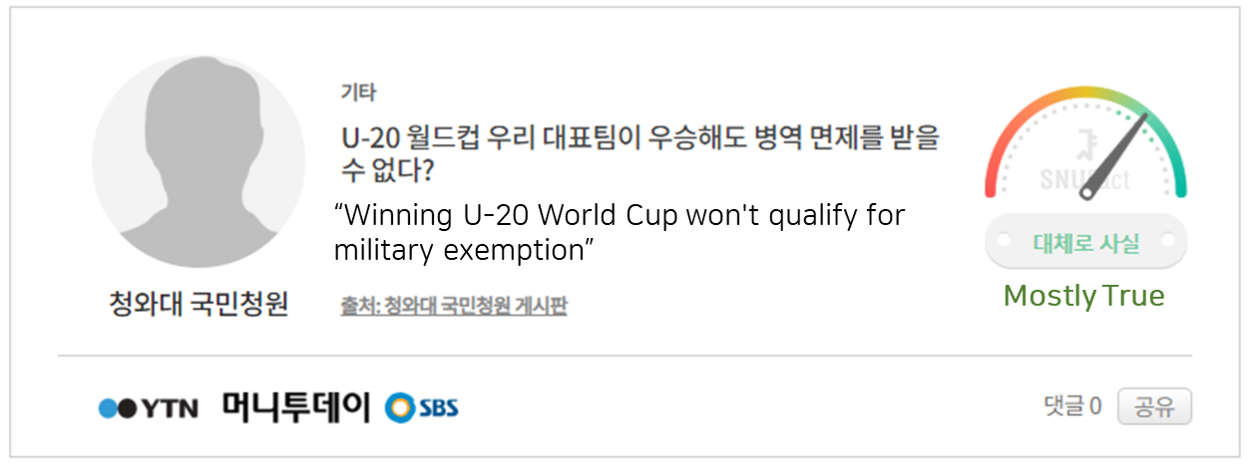
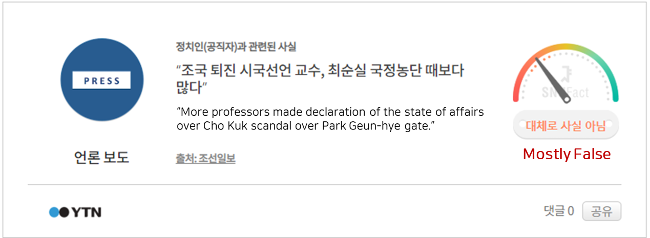
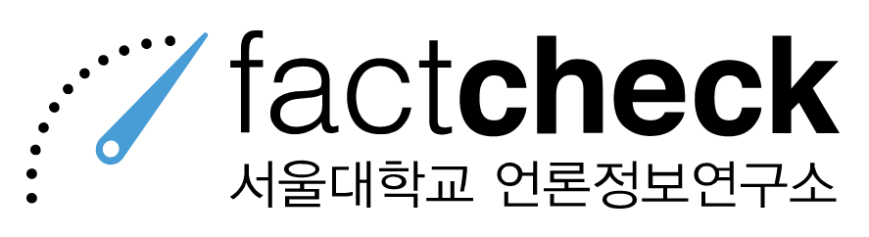
Fact Check
A quick quiz
I’ll read a statement. After counting five, you raise your hand to either True or False
Verified by

Slide 3
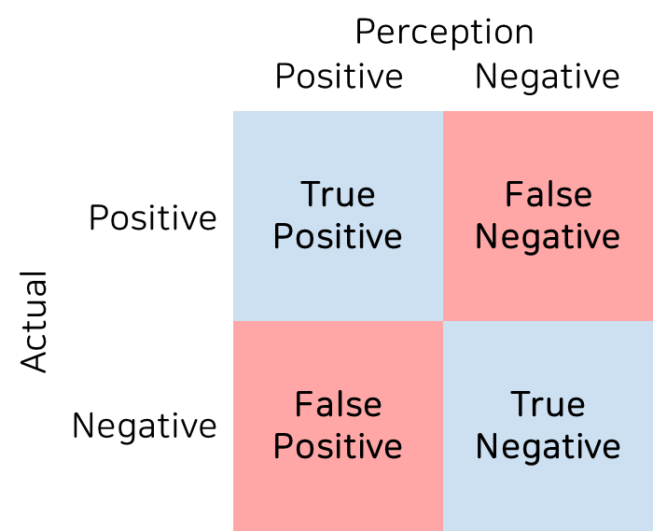
The Paper
Claims
C1) wisdom of crowds (average truth rating) is inaccurate
C2) The false positive perception bias and false negative perception bias are both prevalent
C3) User’s political ideologies influence their truth perceptions for the most controversial stories
Set Goals
G1) Remove false news stories from circulation
G2) Correct the misperception of the users
G3) Decrease the disagreement between different users’ perceptions of truth

Slide 4
Presentation Outline
Methodological
Empirical
Practical
Methods
Results
Proposal
- Dataset - Truth Perception Test
V1) Sample effects
V2) Answer choice effects
V3) Satisficing and Incentive effects
- C1. Bias in collective wisdom of crowds
- C2. Bias In individual truth perceptions
- C3. Disputability in Individual truth perceptions
- G1. remove false news
- G2. Correct the misconceptions
- G3. Decrease the disagreement

Slide 5
Presentation Outline
Methodological
Empirical
Practical
Methods
Results
Proposal
- Dataset - Truth Perception Test
V1) Sample effects
V2) Answer choice effects
V3) Satisficing and Incentive effects
- C1. Bias in collective wisdom of crowds
- C2. Bias In individual truth perceptions
- C3. Disputability in Individual truth perceptions
- G1. remove false news
- G2. Correct the misconceptions
- G3. Decrease the disagreement

Slide 6

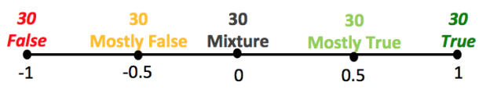
Dataset - Snopes
- One of the first online fact-checking websites. - "well-regarded source for sorting out myths and rumors"
- 5 scales for labeling truth level
https://www.snopes.com/fact-check/golfing-robot-hit-a-hole-in-one/
Notes:
They used 150 fact checked stories from snopes

Slide 7
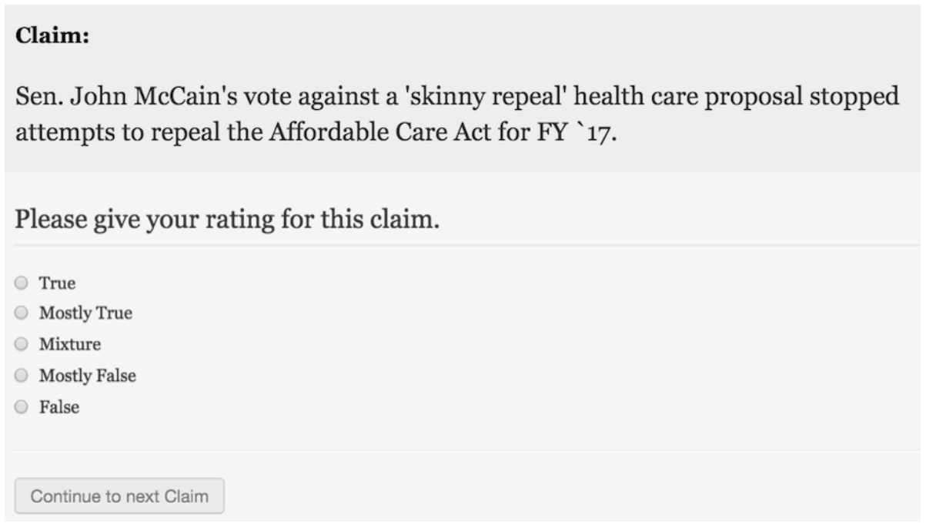
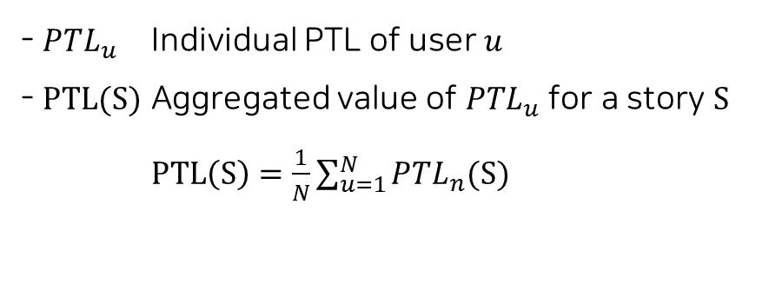
Truth Perception Test
Strongly encouraged the respondents to respond rapidly.
No external resources. Rely on your gut!
PTL (Perceived Truth-Level)
- $PTL_{u}$ Individual PTL of user $u$
- $PTL(S)$ Aggregated value of $PTL_{u}$ for a story $S$
$PTL\left(S\right)=\frac{1}{N}\sum_{u=1}^{N}{PTL_{n}(S)}$
15,000 Data collected on Mturk (300 Participants x 50 claims)

Slide 8
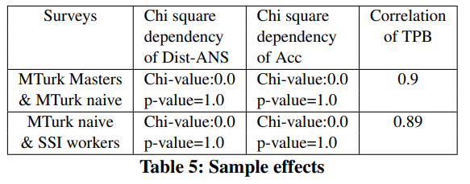
V1. Sample Effects
Concern
“Less-naive (expert) respondents may answer some types of survey questions in different ways than naive respondents”
Variation
Comparison
- Naive MTurkers vs MTurk Masters
- Naive MTurkers vs SSI participants
*SSI: Survey Sampling International
Irrelevant!

Slide 9
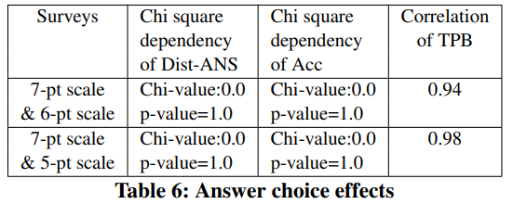
V2. Answer Choice Effects
Concern
“Showing even- vs. odd- numbered options to answer may effect the result.”
“The text labels of the answer choices affect the result.”
Variation
Comparison
7 point scale vs 6 point scale
7 point scale vs 5 point scale
Irrelevant!

Slide 10
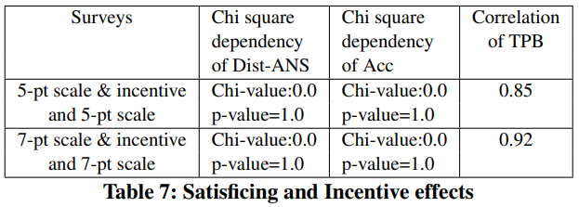
V3. Satisficing and Incentive Effects
Concern
“Incentivizing may affect the result”
Variation
Comparison
Incentive vs No-incentive (7 point scale)
Incentive vs No-incentive (5 point scale)
*Incentive policy:
5 cents for correct perception taking less than 15 seconds
Irrelevant!

Slide 11
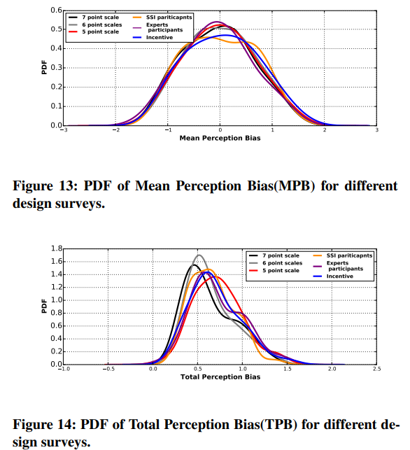
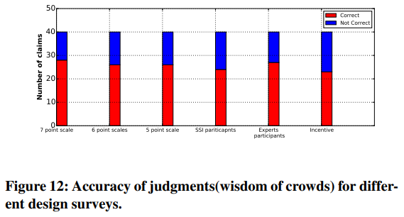
Validation
No statistically significant differences across the survey variations.

Slide 12
Presentation Outline
Methodological
Empirical
Practical
Methods
Results
Proposal
- Dataset - Truth Perception Test
V1) Sample effects
V2) Answer choice effects
V3) Satisficing and Incentive effects
- C1. Bias in collective wisdom of crowds
- C2. Bias In individual truth perceptions
- C3. Disputability in Individual truth perceptions
- G1. remove false news
- G2. Correct the misconceptions
- G3. Decrease the disagreement

Slide 13
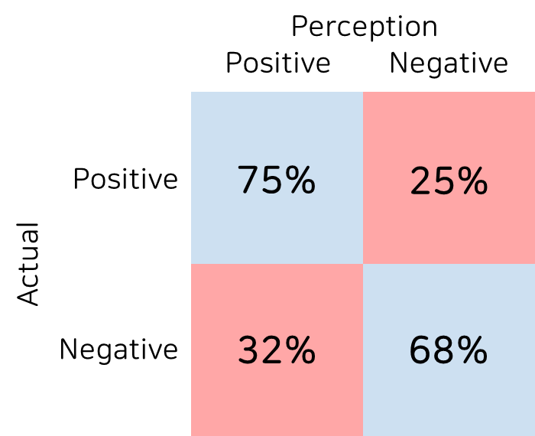
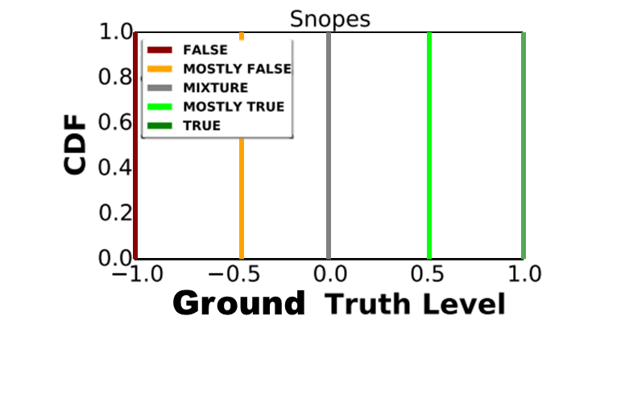
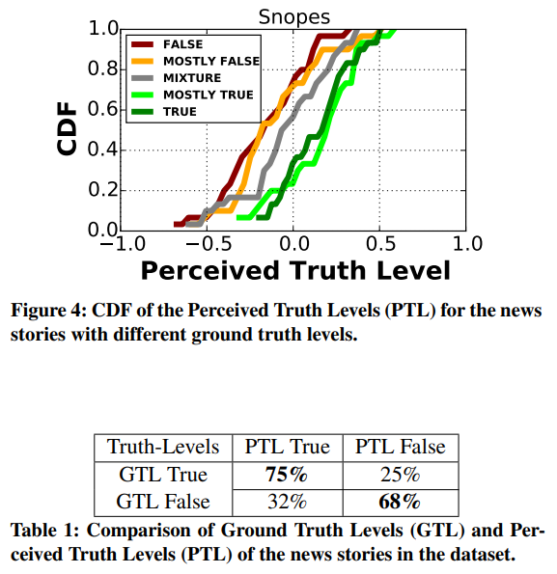
C1. Bias in Collective Wisdom of Crowds
GTL (Ground Truth-Level)
The percentage of stories for which GTL and PTL values have same signs is 75% or lesser
People are often wrong

Slide 14
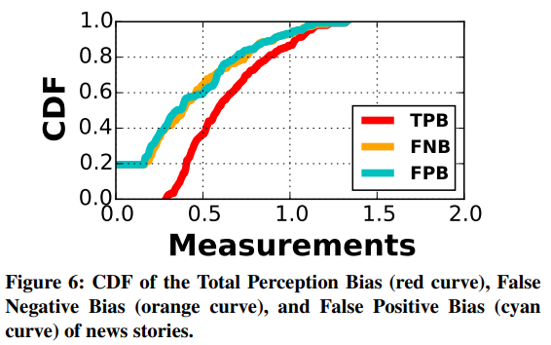
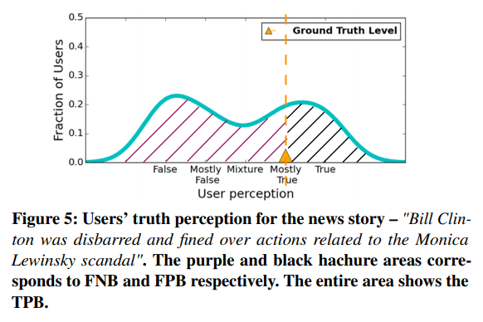
C2. Bias in Individual Truth Perceptions
TPB (Total Perception Bias)
- Total error
FPB (False Positive Bias)
- Gullibility (PTL > GTL)
FNB (False Negative Bias)
- Cynicality (PTL < GTL)
FNB
FPB
People are both gullible and cynical

Slide 15
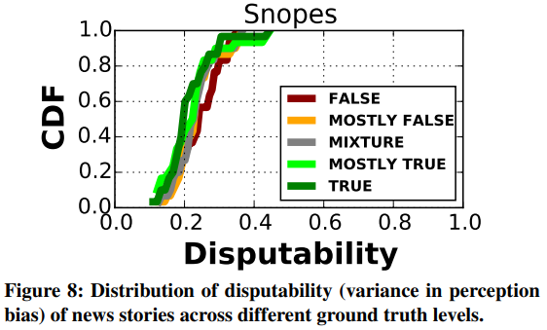
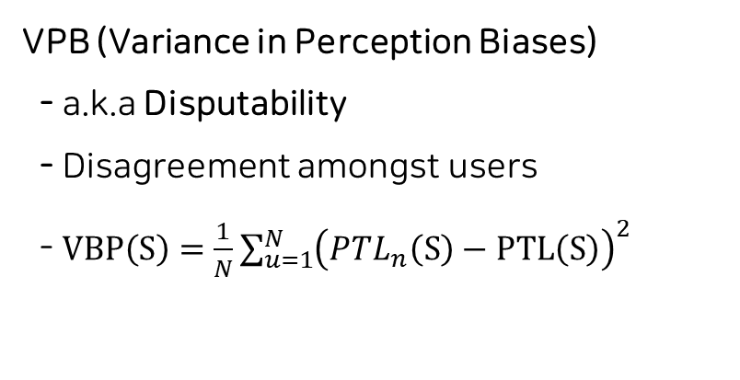
C3. Disputability in Individual Truth Perceptions
VPB (Variance in Perception Biases)
- a.k.a Disputability
- Disagreement amongst users - $VBP\left(S\right)=\frac{1}{N}\sum_{u=1}^{N}{{\left(PTL_{n}\left(S\right)−PTL\left(S\right)\right)}^{2}}$
Biases vary significantly between users

Slide 16
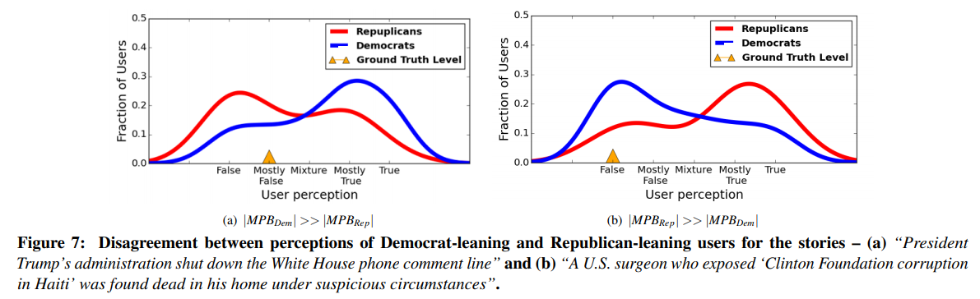
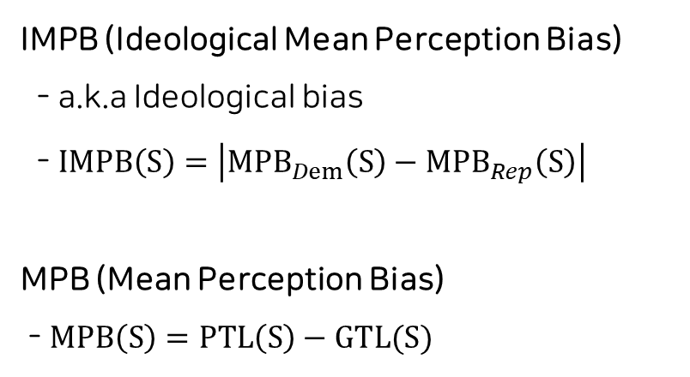
C3. Disputability in Individual Truth Perceptions
VPB (Variance in Perception Biases)
- a.k.a Disputability
- Disagreement amongst users - $VBP\left(S\right)=\frac{1}{N}\sum_{u=1}^{N}{{\left(PTL_{n}\left(S\right)−PTL\left(S\right)\right)}^{2}}$
IMPB (Ideological Mean Perception Bias)
- a.k.a Ideological bias
- $IMPB\left(S\right)=\left|MPB_{Dem}\left(S\right)−MPB_{Rep}\left(S\right)\right|$
MPB (Mean Perception Bias)
- $MPB\left(S\right)=PTL\left(S\right)−GTL(S)$
People trust/distrust stories that confirm or contradict their political beliefs

Slide 17
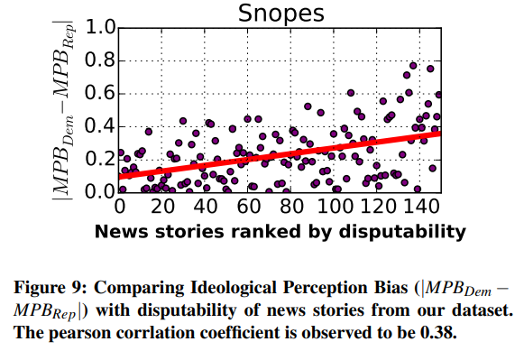
C3. Disputability in Individual Truth Perceptions
VPB (Variance in Perception Biases)
- a.k.a Disputability
- Disagreement amongst users - $VBP\left(S\right)=\frac{1}{N}\sum_{u=1}^{N}{{\left(PTL_{n}\left(S\right)−PTL\left(S\right)\right)}^{2}}$
IMPB (Ideological Mean Perception Bias)
- a.k.a Ideological bias
- $IMPB\left(S\right)=\left|MPB_{Dem}\left(S\right)−MPB_{Rep}\left(S\right)\right|$
MPB (Mean Perception Bias)
- $MPB\left(S\right)=PTL\left(S\right)−GTL(S)$
High disputability arises from ideologically polarized perception

Slide 18
Presentation Outline
Methodological
Empirical
Practical
Methods
Results
Proposal
- Dataset - Truth Perception Test
V1) Sample effects
V2) Answer choice effects
V3) Satisficing and Incentive effects
- C1. Bias in collective wisdom of crowds
- C2. Bias In individual truth perceptions
- C3. Disputability in Individual truth perceptions
- G1. remove false news
- G2. Correct the misconceptions
- G3. Decrease the disagreement

Slide 19
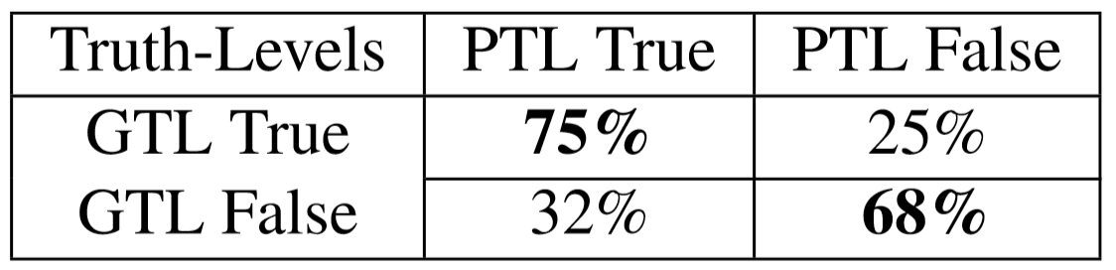
G1. Remove False News
-Wisdom of Crowd
-Use Perceived Truth Level to estimate Ground Truth Level
-PTL False with GTL False : 68%(Accuracy)
-This method is not sufficient to achieve G2 and G3

Slide 20
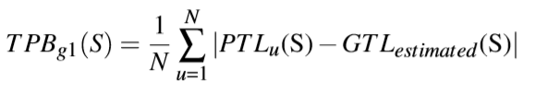
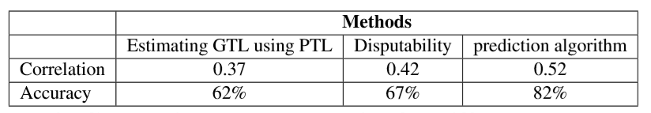
G2. Correct the Misperception
Goal is reducing bias(Total Perceptive Bias(TPB))
1. GTL estimated : GTL achieved in G1 method
2. Disputability is good metric that highly correlated with TPB
3. Use linear SVM (Regression) with user demographics (gender, education classification, political views) and TPB

Slide 21
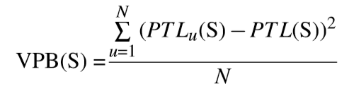
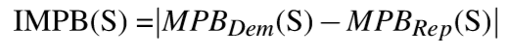
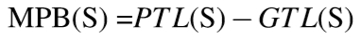
G3. Decrease the Disagreements
For this goal, we should select high ideology biased story
VPB(Disputability) is correlated with ideology bias.
VPB is easy way to calculate without user’s background data(Democratic or Republican)
IMPB is ideal way but need user’s background data

Slide 22
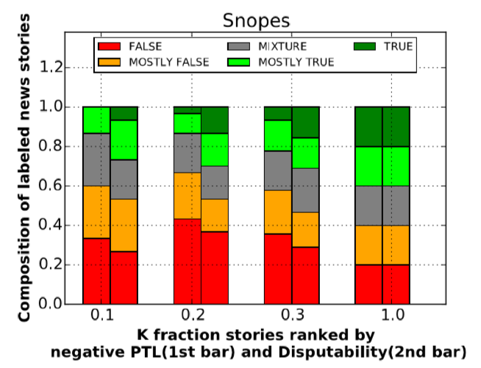
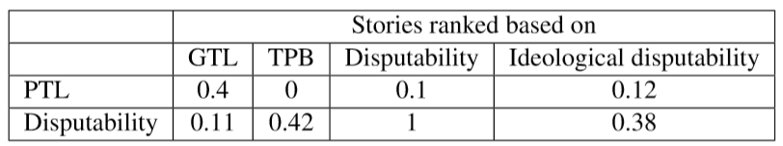
Pitfall of current strategy
Estimate with PTL(current strategy of fake new detecting)is not good to reduce bias
Disputability can be answer of it

Slide 23
Conclusion
Wisdom of perception is not that accurate
False positive perception bias and false negative perception bias are both frequently appeared
Political ideologies influence people’s perception in stories that have highly disputed truth level perception
Current strategies have limit
Proposed selection mechanism can be solution
Paper propose three goals because there were not clear goals

